Slide 1


Predicting employee attrition using Machine Learning
Presented by Wambui Ng'ang'a

Slide 2

Dataset
To predict which employees are likely to leave the company using Employee Attrition dataset downloaded from Kaggle:
https://www.kaggle.com/analystanand/employee-attrition
OBJECTIVE

Slide 3
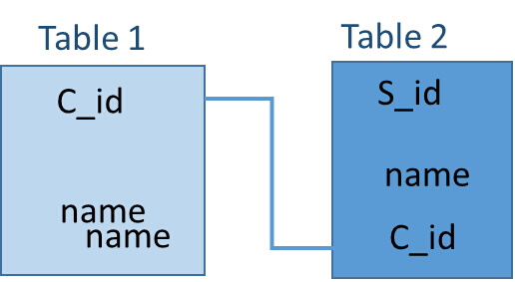
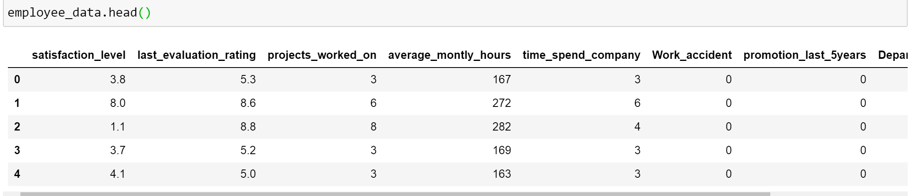
Description of the dataset
The dataset contains 25491 observations and 10 variables with columns containing employee attributes and rows representing employees.

Slide 4
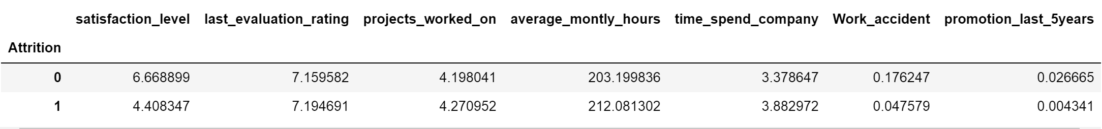
Explorative Data Analysis
Exploring the dataset to find out the relationships between the features. 5990 employees left the company. From the analysis, more employees stayed in the company. Those who are likely to leave the company worked more hours than who stayed, had accidents at work and were not promoted.

Slide 5
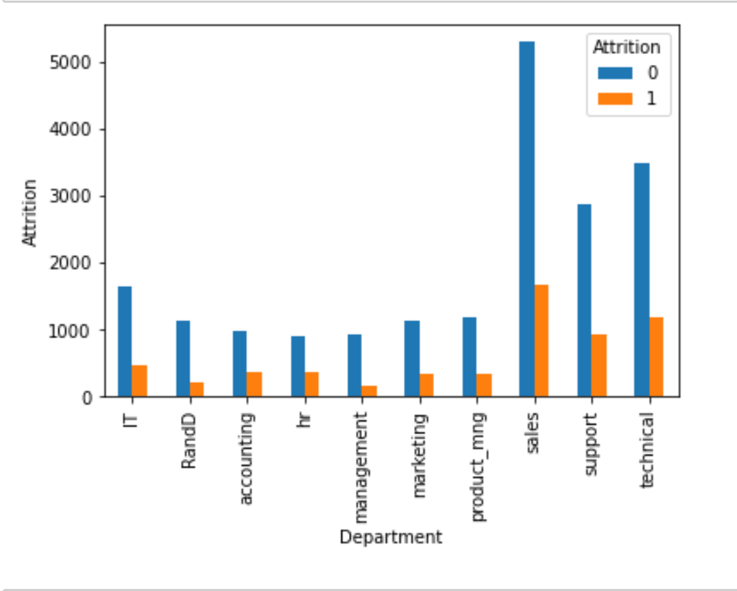
40
30
The department which the employee works in could be a factor in employee attrition.
20
10
0
Item 1
Item 2
Item 3
Item 4
Item 5

Slide 6
In preparation for model building, the dataset is separated into train and split sets using scikit-learn library.
Model Building

Slide 7
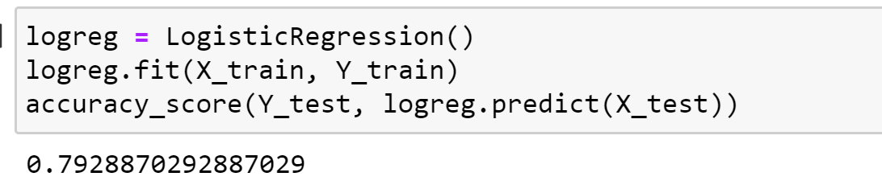

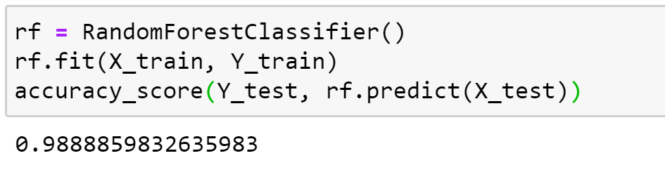
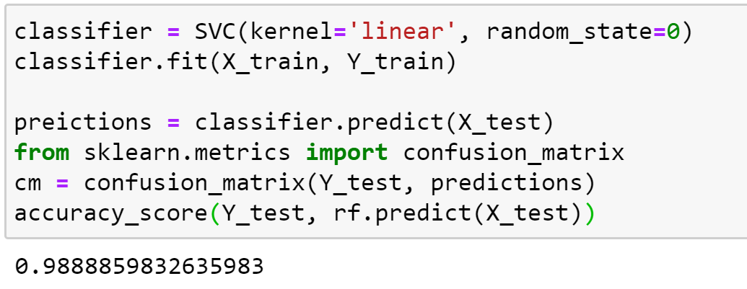
Logistic Regression
Random Forest
Support Vector Machine

Slide 8
RESULTS
Random forest classifier and Support vector machine are our best models for predicting employee attrition. Both attained an accuracy of 98%

Slide 9
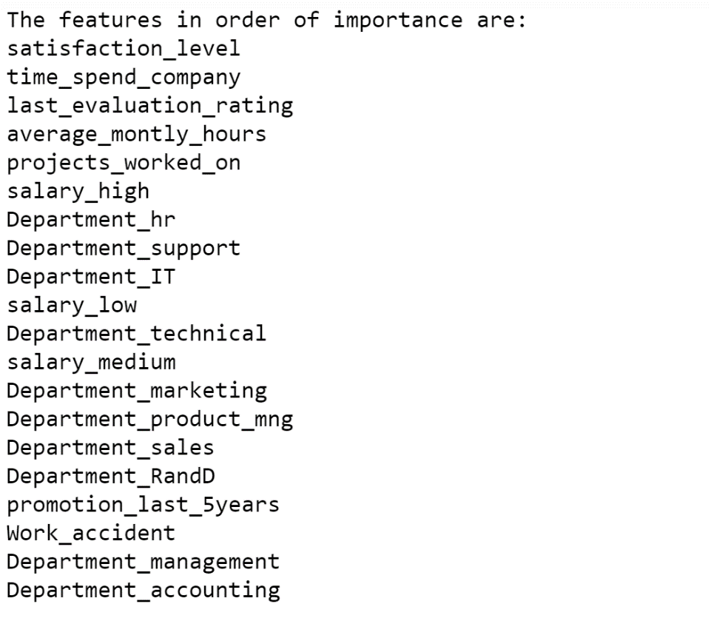
CONCLUSION
Employee attrition depends on the features as listed on the right.

